Slide 1

4-6: Hard start jump to easy
By Barbara Oakley, PhD

Slide 2
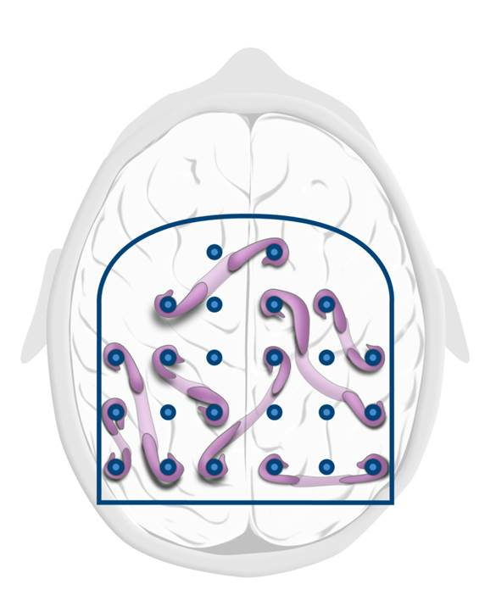



Slide 3
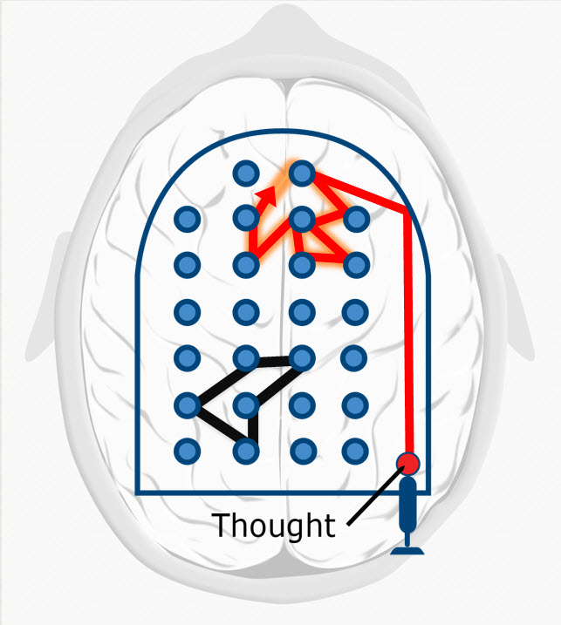
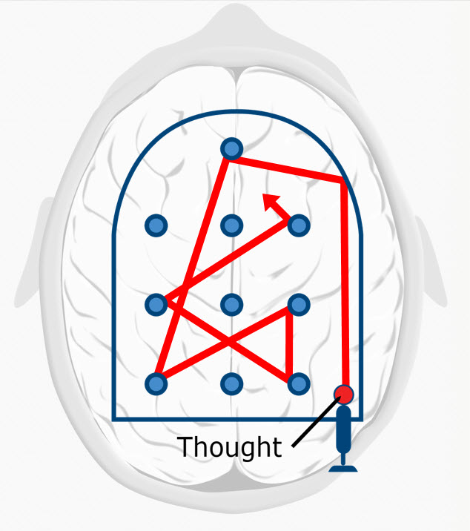
Hard-start-jump-to-easy technique
Focused mode
Diffuse mode

Slide 4
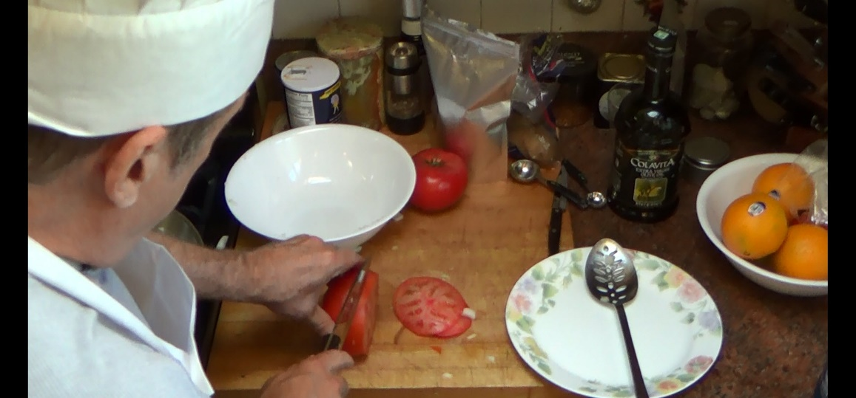
Hard start – jump to easy

Slide 5


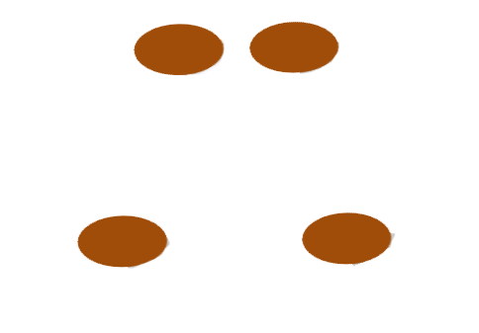


Slide 6
Illustration credits
Focused and diffuse mode, ©Kevin Mendez, 2014.
Zombie ©Kevin Mendez, 2014.
Chef at work courtesy Philip Oakley, ©Philip Oakley, 2014.
Neural ribbons ©Barbara Oakley
Clip art courtesy Microsoft Corporation
Relevant readings
Oakley, Barbara (2014). A Mind for Numbers: How to Excel at Math and Science (Even If You Flunked Algebra). New York, NY: Penguin-Random House. See in particular chapter 17.

